Slide 1
Theory of Automata
بِسْمِ اللهِ الرَّحْمٰنِ الرَّحِيْمِ
Lecture # 07
Imtiaz Ahmed

Slide 2
Dead States in Finite Automta
Construct FA's for following languages over alphabet (a,b)
1 - exactly 2 a's
2 - at most 2 a's
3 - at least 2 a's

Slide 3
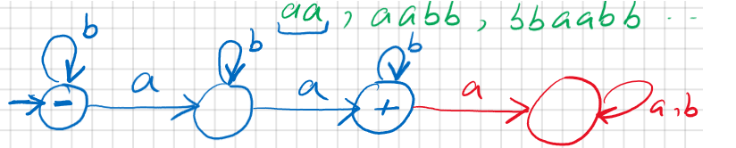
1 - exactly 2 a's

Slide 4
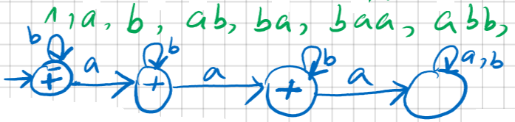
2 – At Most 2 a's

Slide 5
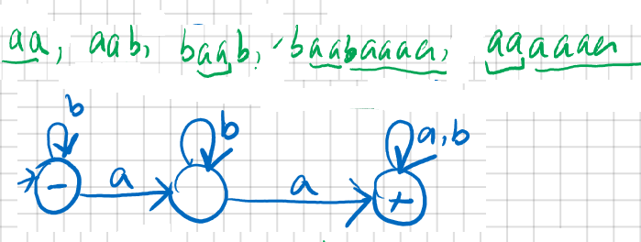
3 – At Least 2 a's

Slide 6
Thanks!
Any question?

